Slide 1



Advanced Database Management Systems
Group Assignment

Slide 2



Introduction
Company :- marketeka.lk
List Item
Purchase Item

Slide 3

Objective
Developing a shopping application to seller

Slide 4

Problems
It do not have a proper UI.
There was no any database to collect the statistics for the seller.

Slide 5
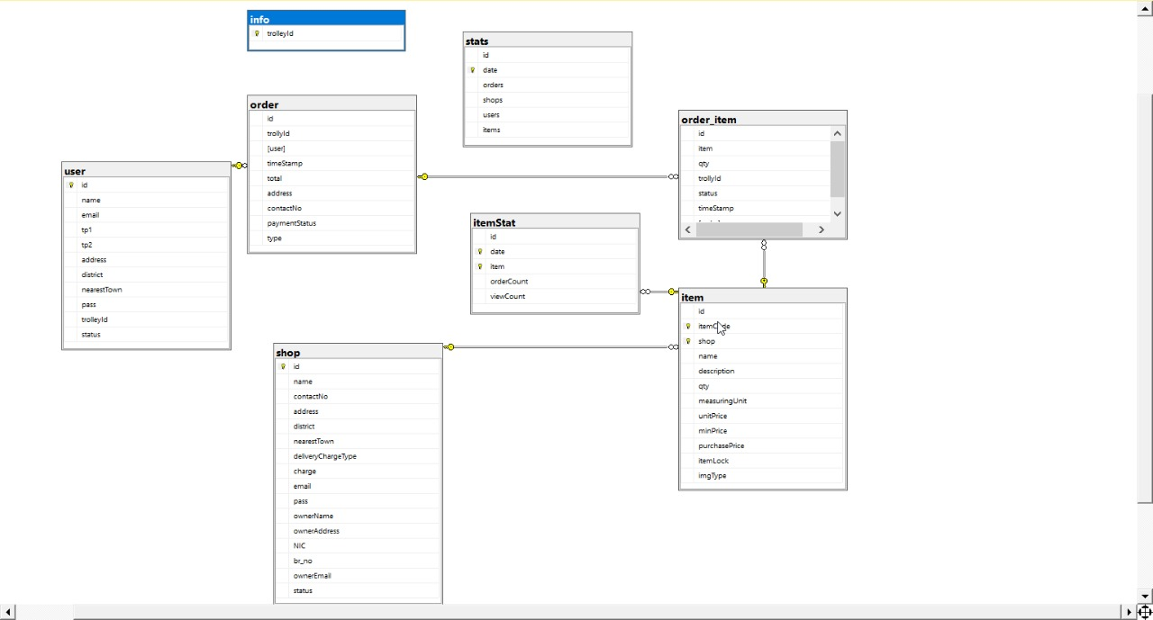
Relational Schema Diagram
The Database

Slide 6
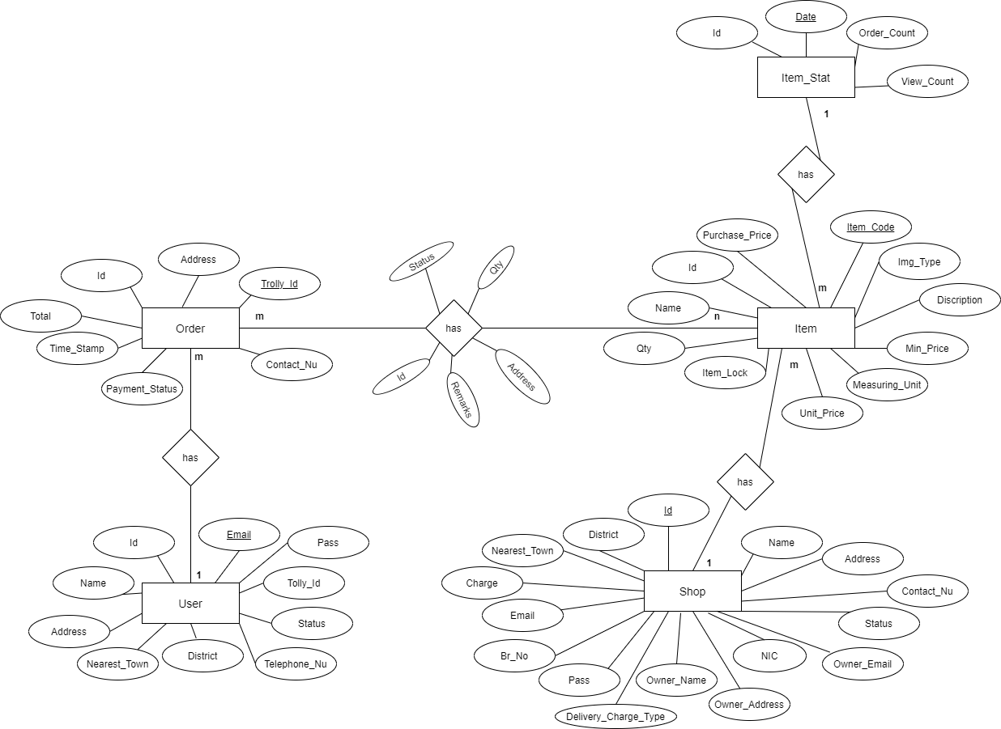
Entity Relationship Diagram

Slide 7
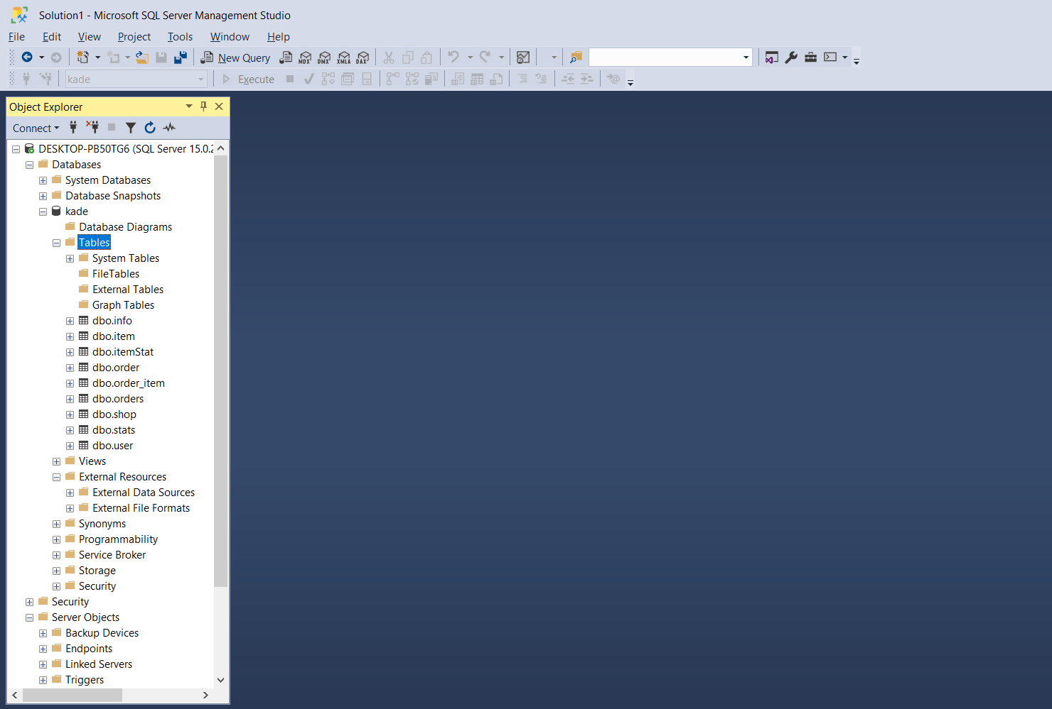

Table Structure

Slide 8
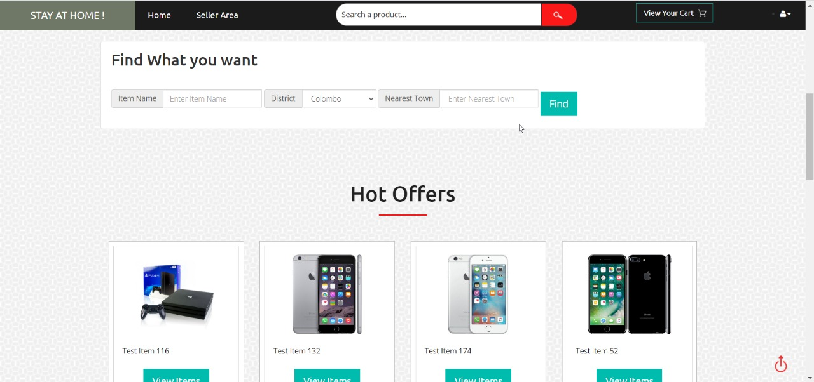
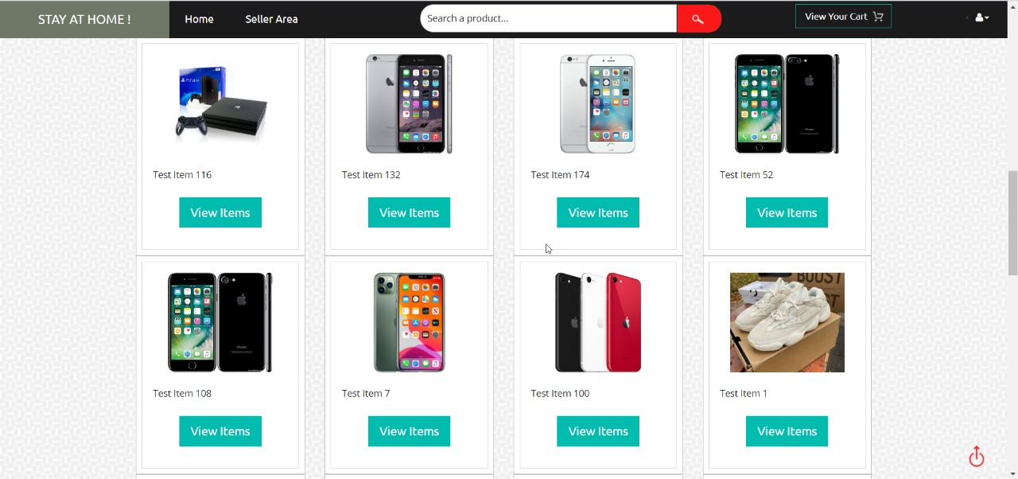
Outputs

Slide 9
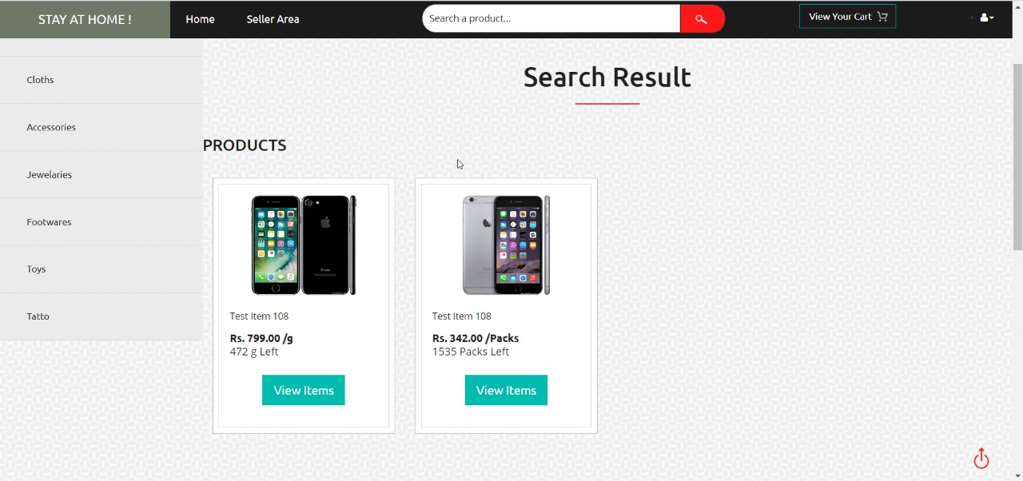
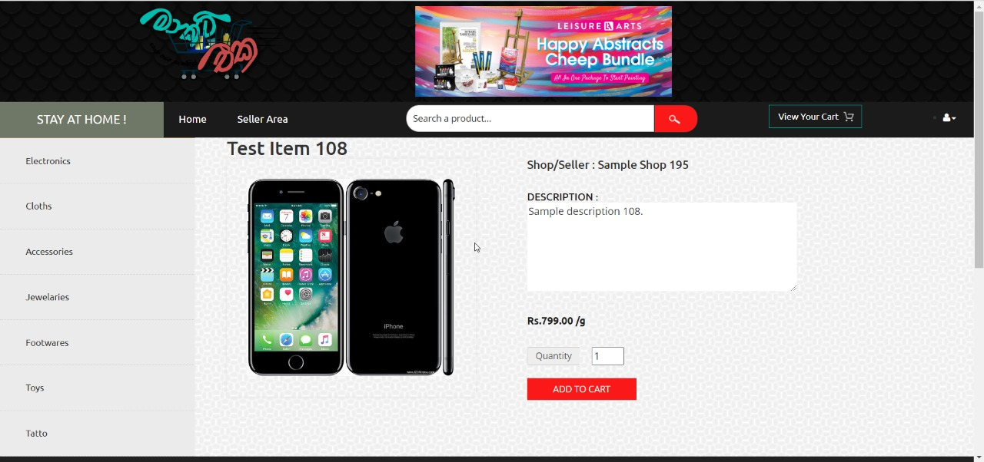
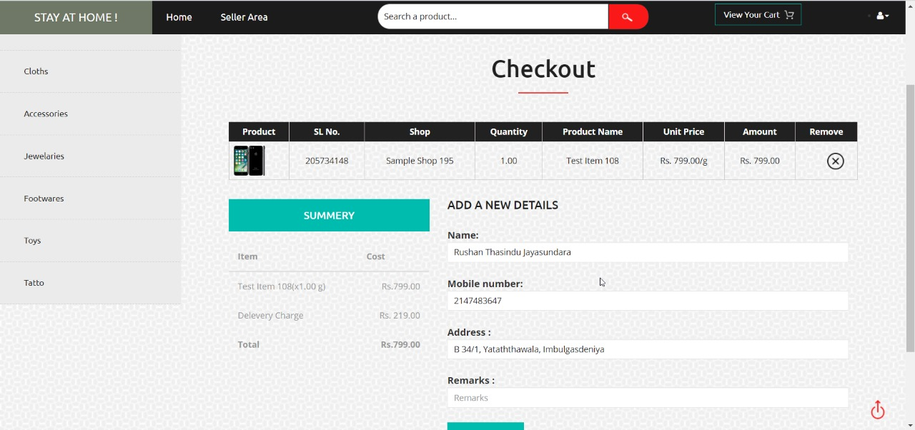
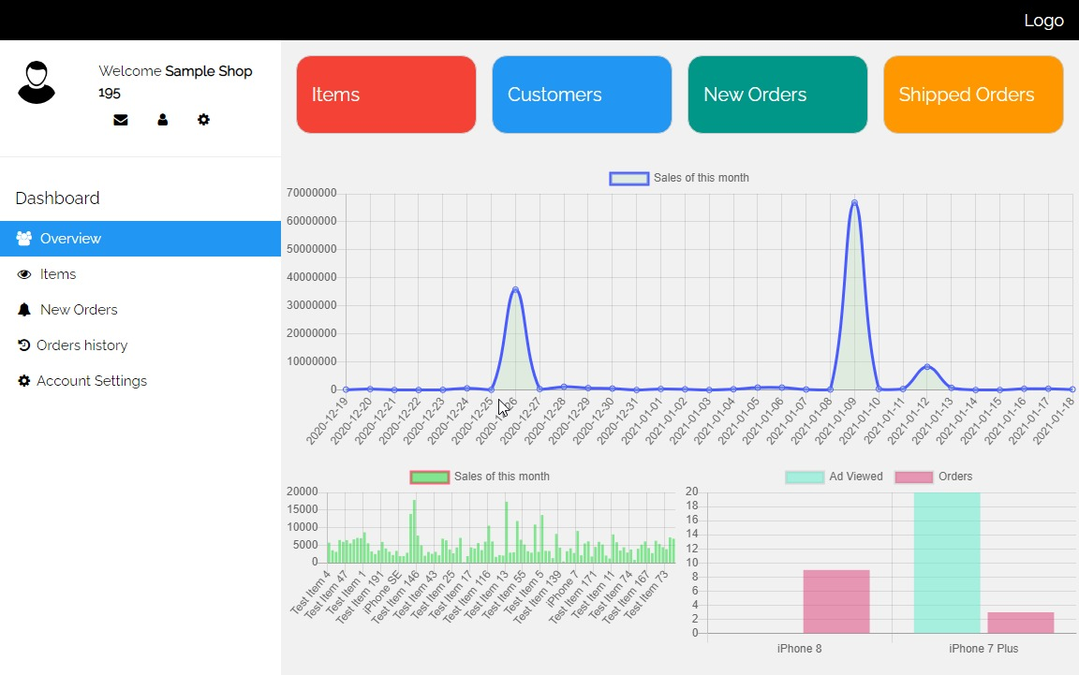

Slide 10

Advantages
Any seller can register this system and after they can sale their products
Seller can see inventory sales statistics
This system works also POS system

Slide 11

The Future Implementation
A combination of a shopping cart & POS system

Slide 12

Thank you!

